Slide 1
Intro to Java

Slide 2
Rules
Don't be intimidated
Ask questions!

Slide 3
Eclipse
IDE – Integrated Development Environment
  Many tools in one program
Workspaces – a way to organize projects
  Each workspace can have multiple projects
  We'll use one workspace for Minecraft and another for our lessons

Slide 4
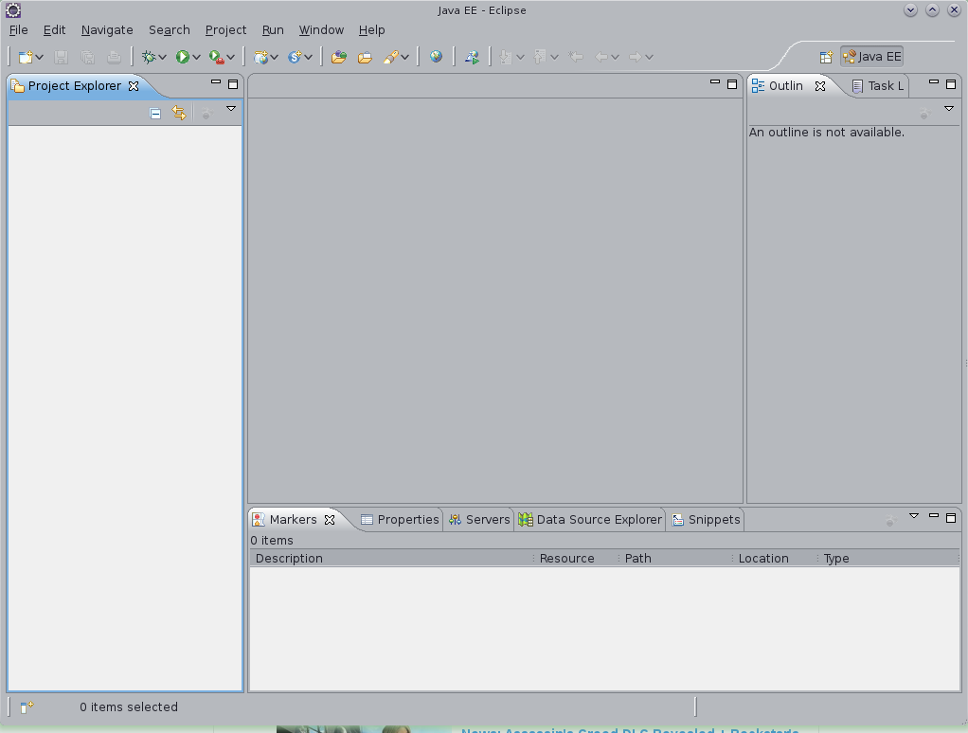
Our files will go
here!
Code will go here!
Code will go here!
Messages will go here!

Slide 5
Eclipse
Open eclipse and create a workspace
  File → Switch Workspace → Other
  C:\dojo\workspace\
Create a new project
  File → New → Project... → Java Project
  Lesson 1
  Finish

Slide 6
Java
Classes – are things
  public class Block { }
Variables – hold information
  int density = 1000;
Methods – do stuff
  public static void addRecipe(ItemStack output, ItemStack[][] input){ }

Slide 7
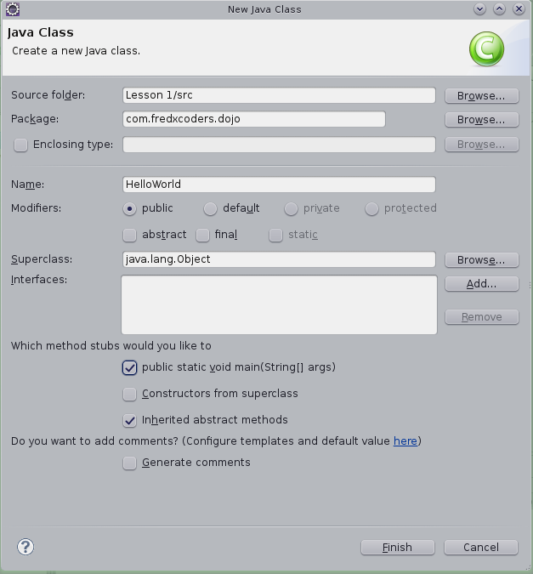
Hello World
File → New → Other...
Search for “Class”

Slide 8
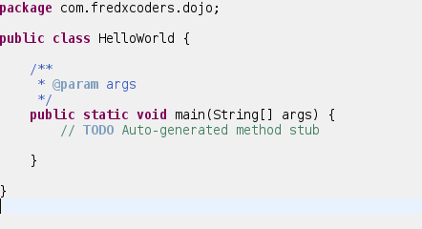
Your first class: Hello World
Comments (not code!)

Slide 9
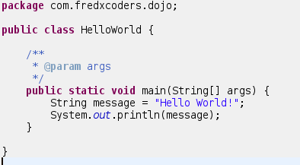
Hello World

